Slide 1
Basic Digital Forensics FBI Cyber Training Bosnia 2019
Notes:
The original version of this presentation was prepared in April 2017 by Sherman Kwok, SVRCFL and Brian Nishida, NMRCFL from OTD’s Digital Evidence Staffing, Education & Development (DESED). SA Jason Myszkiewicz reached out to both individuals and was granted permission to use the presentation in whole or in part. Both of the individuals also offered to provide assistance if necessary.

Slide 2
Learning Objectives
Identify categories of digital evidence.
Define digital forensics.
Describe role of digital forensics in incident response.
Explain the three forensic principles.
Describe the digital forensics examination workflow.
Distinguish between a clone and an image.
Use FTK Imager to create an image of a thumbdrive.

Slide 3
Learning Objectives
Explain the importance of MD5 verification.
Describe different methods for searching digital evidence.
Describe the value of the different types of artifacts found on digital evidence.
Use Registry Viewer to view registry files.
Explain the importance of documenting your results.

Slide 4
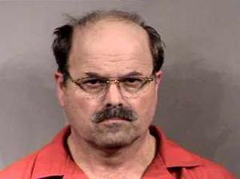
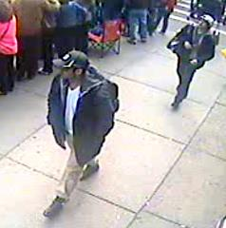
Computer Forensics In Action
BTK Killer (Kansas, 2004): metadata
Boston Bombers (2013): surveillance videos
In most cases, computer forensics is just one part of the investigation

Slide 5
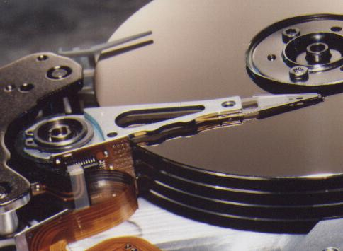
Digital Evidence Categories
Communications: e-mail, chat, text messages, etc.
Documents: papers, pdf files, classified information
Internet activity: history, Google Searches, downloads
Financial information: spreadsheets, databases
Multimedia: Photographs, videos, graphics
Logs: Application, Host, Network
Malware
And more …
Notes:
Old days: typewriters, fingerprints, postage stamps, boxes of paper records
Now: everything is on computers, networks, and smartphones

Slide 6

Law Enforcement Investigations
Computer Intrusion
Crimes Against Children
Terrorism
Espionage
Financial Crimes
Public Corruption
Violent Crimes
Narcotics
Notes:
What types of investigations are you doing here? (great opportunity to learn what type of investigations the students are involved in)

Slide 7
Digital Forensics Definition
Forensics refers to the application of investigative and analytical techniques that conform to evidentiary standards, and are used in, or appropriate for, a court of law or other legal context.
Source: Section 3 (v) IRR of R. A. No. 10175
Notes:
This slide is a specific definition from Philippine law.

Slide 8
Digital Forensics Definition
“…the application of science to the identification, collection, examination, and analysis of data while preserving the integrity of the information and maintaining a strict chain of custody for the data.” (NIST)
Source: National Institute of Standards and Technology (2006). Guide to Integrating Forensic Techniques into Incident Response. Recommendations of the National Institute of Standards and Technology, NIST Special Publication 800-86.

Slide 9
Forensics and Incident Response
Why review digital forensics?
Understand how to conduct yourself while responding to an incident (think murder scene),
Recognize the types of data that are available in a given situation, and
Be aware of the tools that can be used to collect and preserve that data.
Notes:
But, there are exceptions to every rule
DNA and fingerprints

Slide 10
Forensic Principles
1: The evidence should not be altered.
2: The examination must be accurate.
3: The examination should be verifiable and repeatable.
Source: Forensic Computing, A Practitioner’s Guide by Tony Sammes and Brian Jenkinson
Notes:
But, there are exceptions to every rule
DNA and fingerprints

Slide 11

Forensic Process
Legal Authority
Collection
Preservation
Examination
Analysis
Results/Presentation

Slide 12
Computer examination workflow
Pre-process Evidence
Convert the data into human readable form
Search the data for Evidence
Write Protect and Image
Extract
Evidence
Generate
Report
Contemporaneous, detailed notes should be taken during the examination.

Slide 13
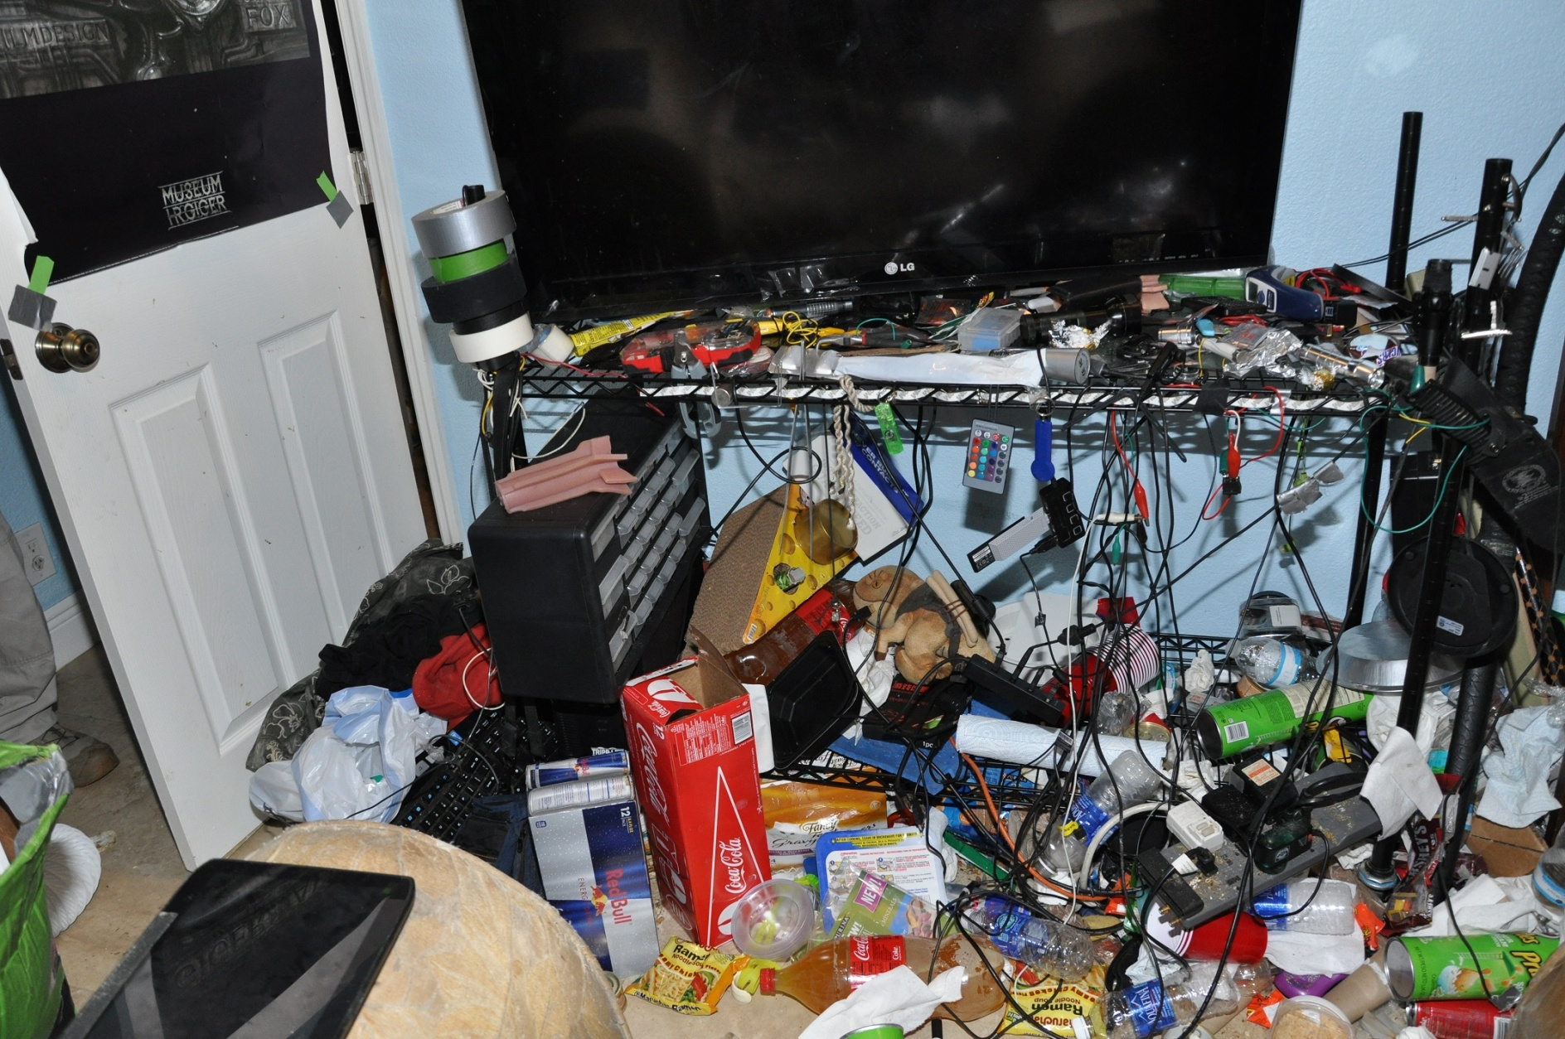
Collection – Seize or Image On-site

Slide 14
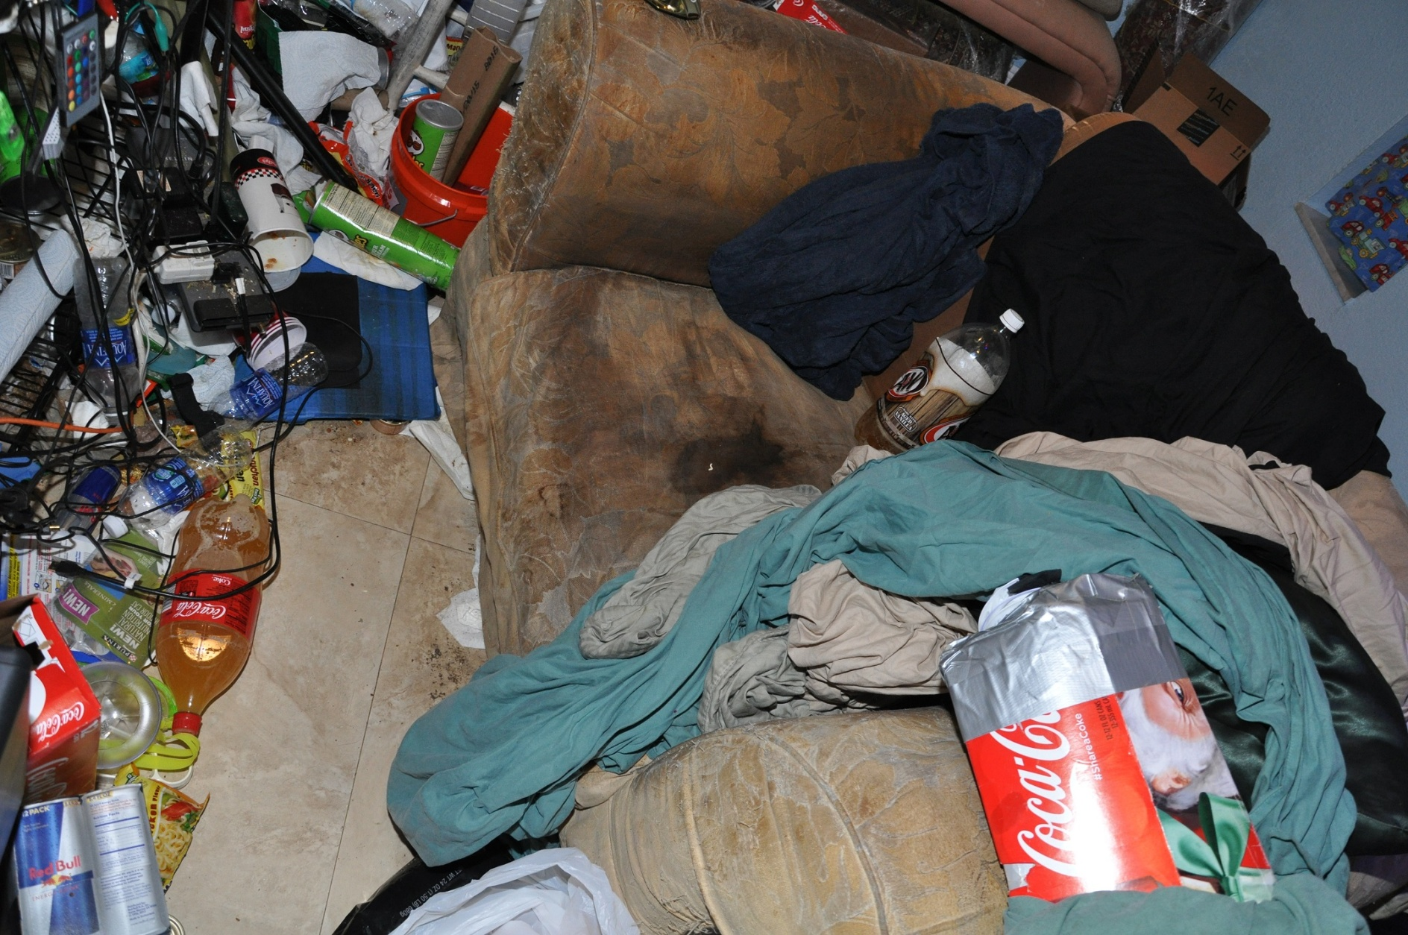
Collection – Seize or Image On-site

Slide 15
Terminology
We won’t be reviewing basic terms, such as file or file system.
However, in digital forensics, it is important to understand the difference between a clone and an image.
Notes:
Old school terminology: mirror image
Remember: computer data is bits and encoding

Slide 16
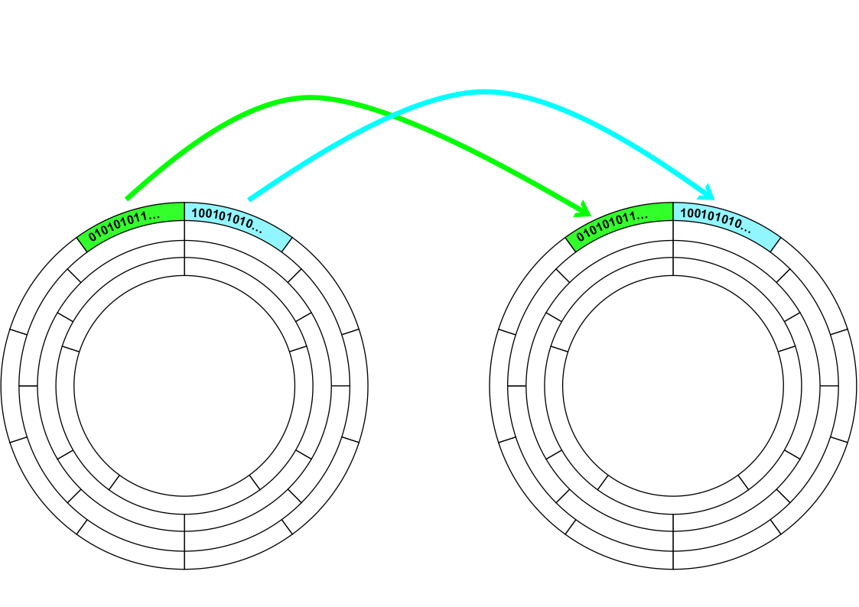
What is a clone?
Sector-by-Sector copy of 0’s and 1’s to sectors of a wiped hard drive
Notes:
We can place the cloned hard drive into the Subject’s computer and boot it up.

Slide 17
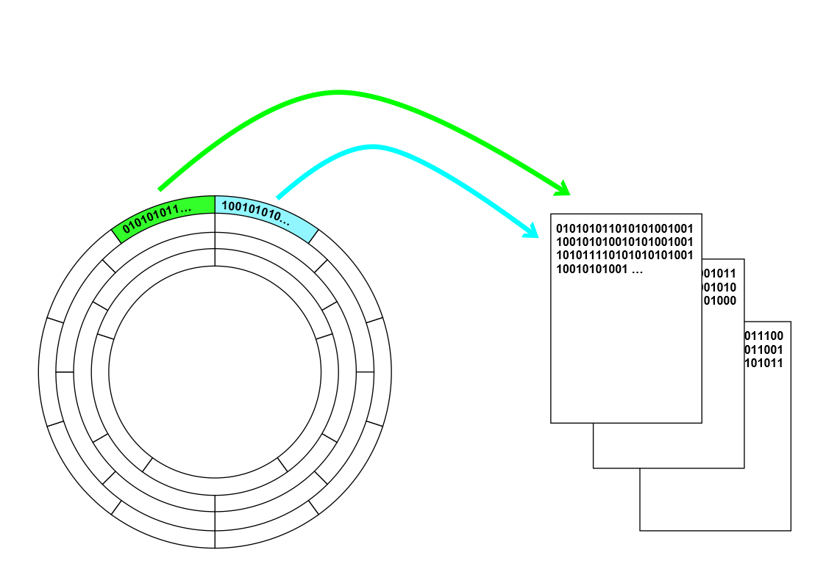
What is an image?
Sector-by-sector copy of 0’s and 1’s to files
Notes:
The image files require Forensic Software to read them.

Slide 18
Image Formats
DD image is “raw” copy of 0’s and 1’s
E01 image in Expert Witness Format or Encase image (compression, CRC checks, password protecting, logs)
AD1 image is AccessData Custom Content Image (image of individual folders, files)
There are more image formats …

Slide 19
Imaging Exercise
Insert your thumb drive.
Delete “Smoking_Gun.jpg” from root folder.
Copy \Software\Imager_Lite_3.1.1 folder to your desktop
Install Registry Viewer
Open Imager_Lite_3.1.1
We’re going to load the thumb drive into Imager and start making a forensic image.

Slide 20
Write blockers
Forensic Principle 1: The evidence should not be altered.
Most Operating Systems will “auto-mount” file systems they recognize. The OS may write to the file system causing modifications to the Original Evidence!
Hardware Write Blockers block write signals to the subject media.
Software Write Blockers use drivers to block write signals to hard drives

Slide 21
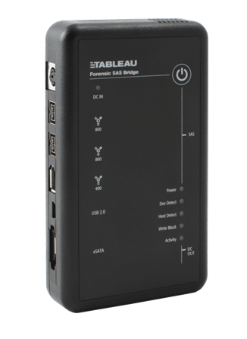
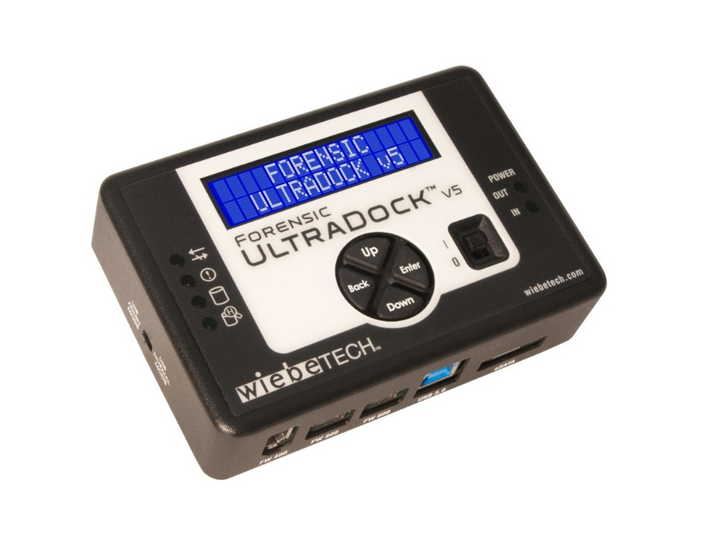
Hardware Write Blockers
WiebeTech UltraDock
Tableau TD35

Slide 22
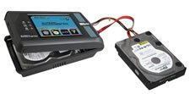
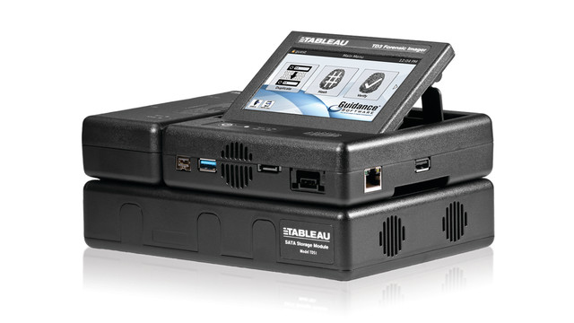
Dedicated Imaging Devices
Tableau TD3
Logicube Supersonix

Slide 23
The Imaging Process
Remove hard drive from computer
Attach write-blocker to specimen hard drive
Attach write-blocker to examination workstation with imaging software
Run imaging software
MD5 verification
Check image

Slide 24
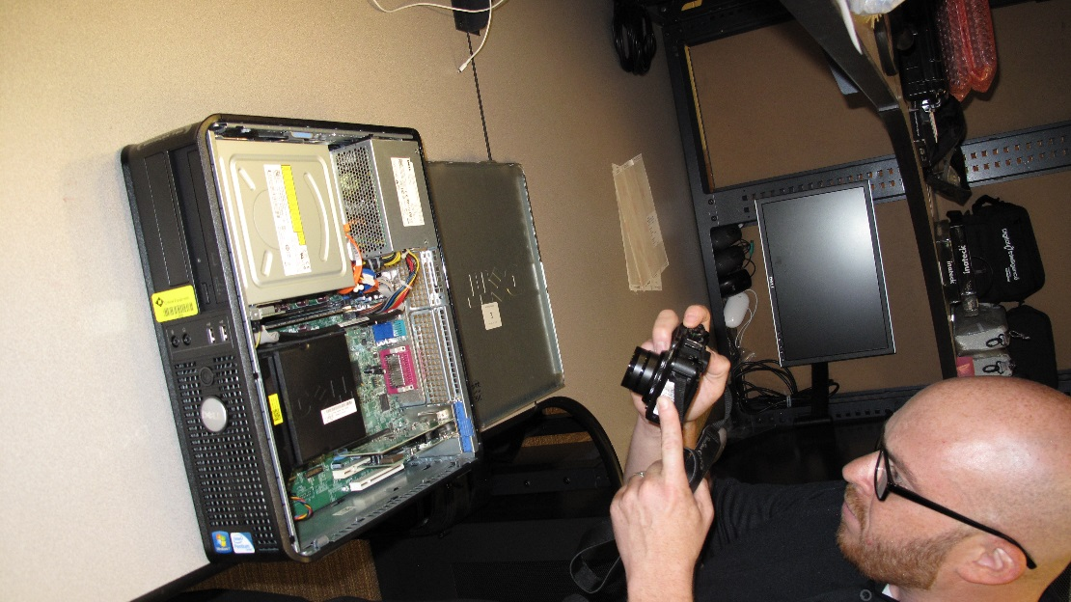
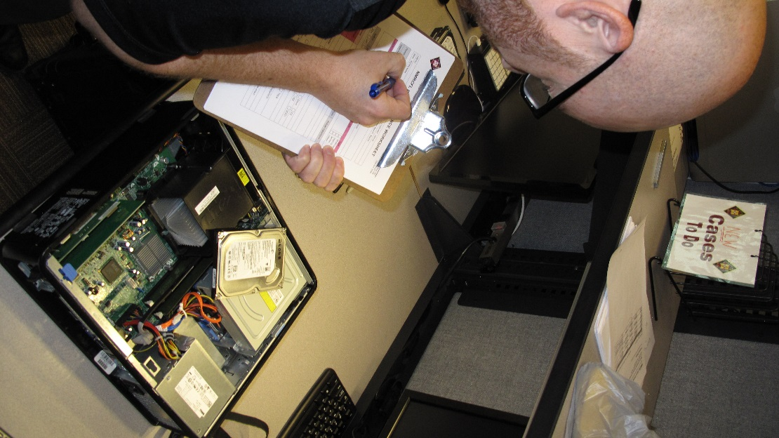
Remove Hard Drive

Slide 25
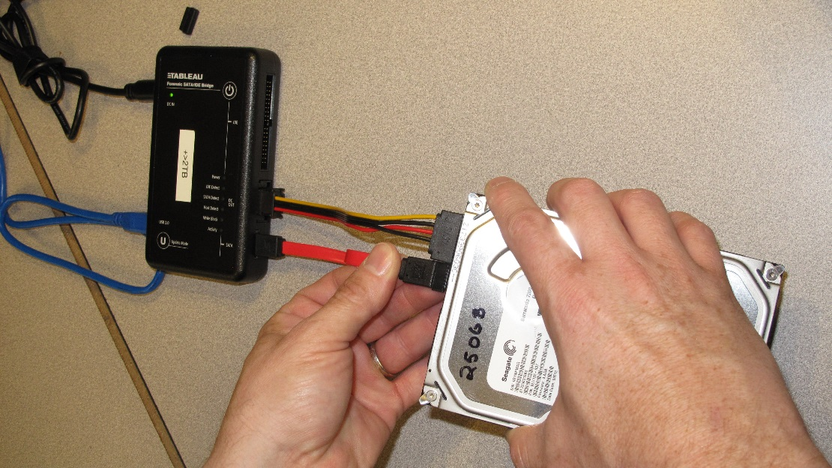
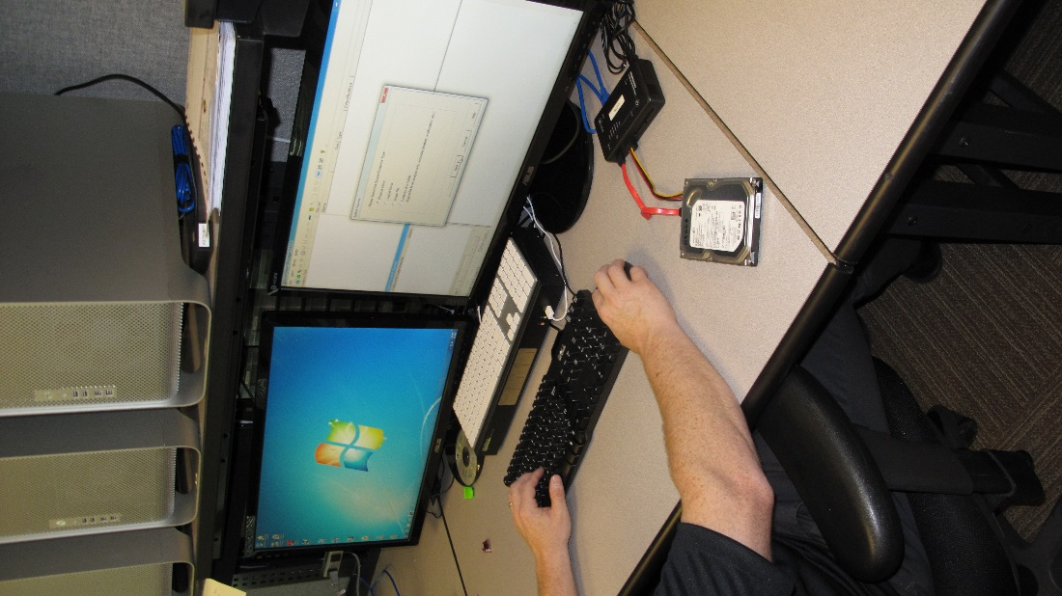
Attach Write Blocker

Slide 26
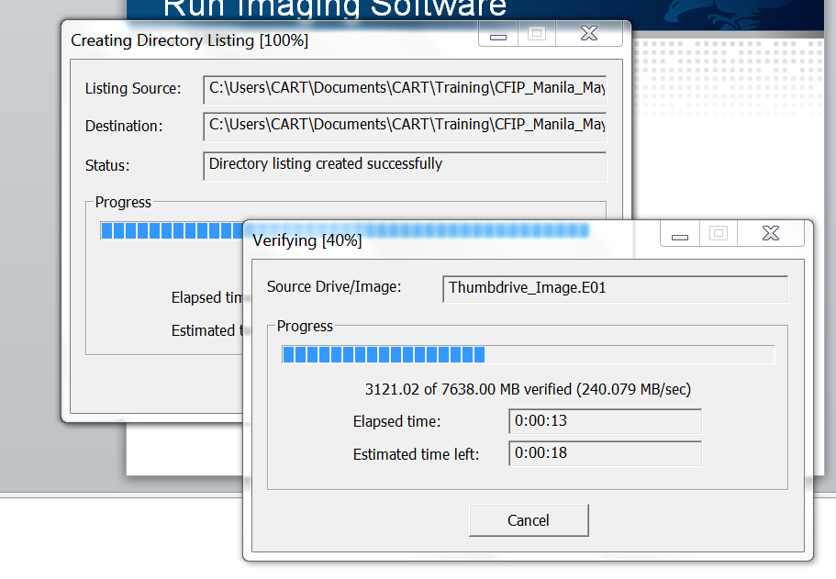
Run Imaging Software

Slide 27
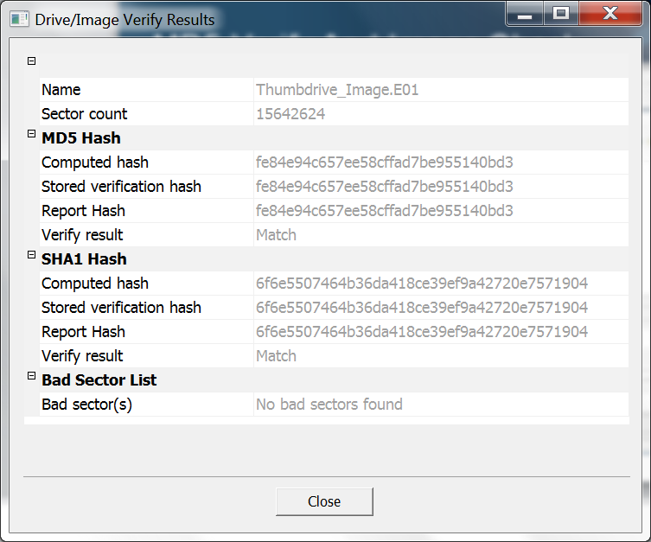
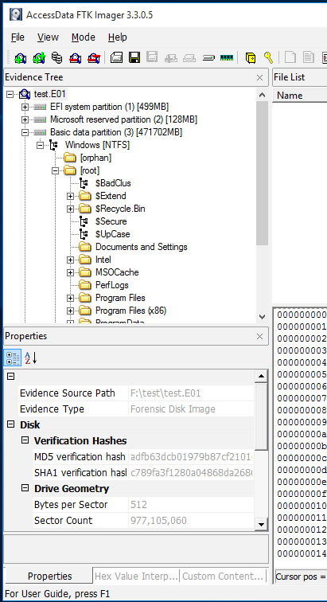
Hash Verify And Image Check

Slide 28

Pre-Processing and De-Coding
Read in the Image
Locate the Partition Table
Transverse each Partition’s File System
Identify and catalog each file in the File System
Process each file (MD5/SHA1/SHA256 hash, index the words, unpack archives and container files, create thumbnails for graphics and videos)
De-code the files for human readability
Notes:
This takes hours or days and is a hands-off, automated process.

Slide 29
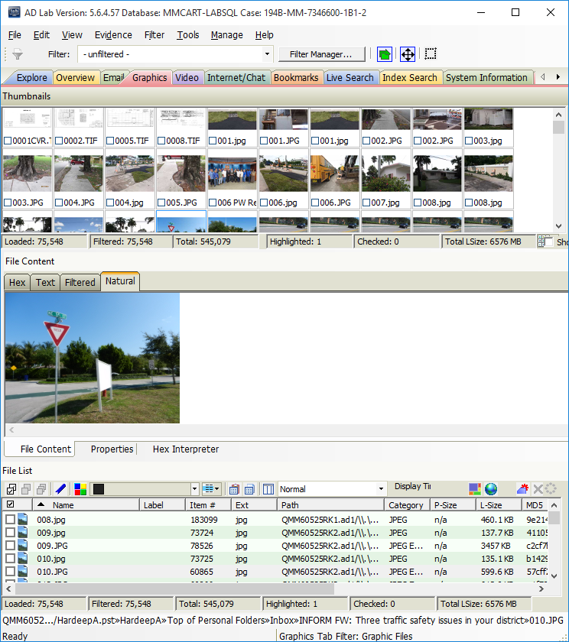
Pre-Processing and De-Coding
Notes:
This takes hours or days and is a hands-off, automated process.

Slide 30
All-In-One Tools
Proprietary: AD Lab, Encase, X-Ways, BlackLight, etc.
Freeware: BackTrack, SIFT, TSK
Image with verification
Decode hundreds of file types
Perform numerous Examination Processes

Slide 31
Specialized Tools
Do a few things well: Internet history, Skype logs, Windows Registry, E-mail, Chats, etc.
May do its one thing better than an All-in-One forensic suite
May be all you need
It is good to have a “Toolbox”

Slide 32



De-Coding All File Types?
Does our forensic software decode the data of interest?
There are tens of thousands (or more) of commercial software programs out there.
There are different versions of commercial software programs.
Most forensic suites can decode only hundreds of file types.

Slide 33
When The Forensic Software Cannot De-Code
Use the native application when the forensic software can not decode.
Boot the image of the Subject computer in a Virtual Machine (discussed later)
Boot the Subject computer with a Clone of the Subject hard drive.
Remember that Binary Files (files not meant to be human readable) must be treated differently, e.g. reverse engineering, sandboxing, etc.

Slide 34
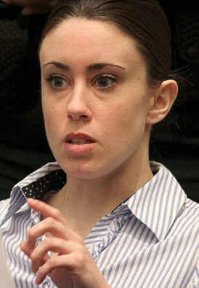
Forensic Principle 2: The examination must be accurate
Casey Anthony Trial
Law Enforcement used Software X which indicated that the word “chloroform” was searched for eighty-four times with Mozilla Firefox.
Defense Expert used Software Y which indicated that the word “chloroform” was searched for only once with Mozilla Firefox.

Slide 35
Ways To Minimize Errors
Be mindful: Push-button Forensics is not a good approach.
Test & Validate the software.
Read the forensic software manufacturer’s limitations.
Try different forensic software to determine if they all arrive at the same answer.
Conduct an experiment using the same software version and conditions of the subject.

Slide 36
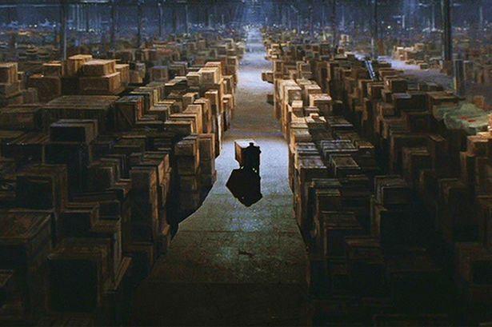

Searching The Data
Notes:
We start with hundreds of thousands or millions of files, and we want to distill this into

Slide 37
The Review Team
Investigator has case specific details
Case Agent
Examiner
Evidence Review
Trial
Attorney
Trial Attorney has prosecutorial knowledge
Examiner has tool knowledge and artifacts knowledge

Slide 38
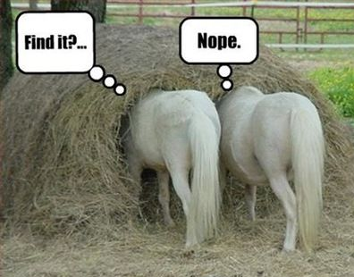
Searching By Keywords
It is desirable to have long, unique keywords
Index Search
Live Search
Proximity and Boolean
Grep or Pattern Search
Credit card numbers
Phone number
IP Addresses

Slide 39
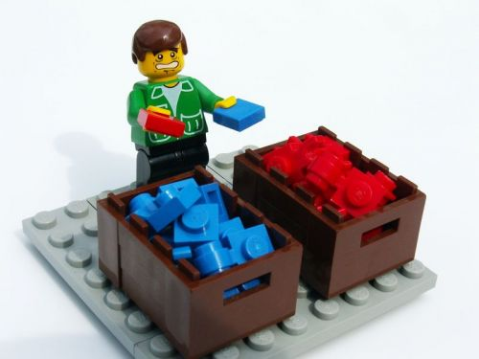
Searching By Sorting
Sort by filename
Sort by timestamps (create, modify, last access)
Sort by file size (encryption containers, virtual machine disks)

Slide 40

Searching By Filtering
Filter by filenames
Filter by e-mail address, chat names, etc.
Filter by a time range of interest
Filter out privileged material

Slide 41
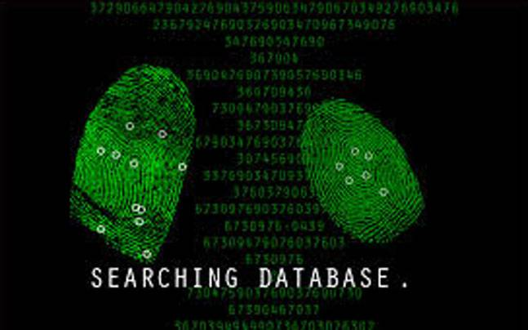
Searching by Hashes
Notes:
We’ll talk about this in more detail, but imagine creating a database of computer files—similar to a fingerprint or DNA database of individuals

Slide 42
Searching By Experience
Resources: Computer Forensics courses, Reference books, Computer Forensics websites
Experienced Computer Examiners will know where things should be on a “normal” system.
Know where artifacts are located to determine whether certain actions occurred.

Slide 43
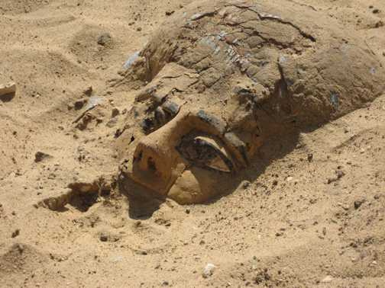
Artifacts

Slide 44
File System Artifacts
When were files created, modified, last accessed?
Were files copied or moved?
Who is the “owner” of the file?
What permissions are set for the files?

Slide 45
Windows Artifacts
What programs were the most frequently executed? How many times were they executed? When was the last date/time of execution? (Prefetch)
When was the first and last time a file was opened? (lnk files, jumplists)
What files were viewed in thumbnail mode? (thumbnail cache)
Were certain folders opened? (shellbags)

Slide 46
Windows Registry
What is the Operating System and when was it installed?
What wireless access points were accessed by this computer?
What are the computer account names, and when was the last time they were logged in?
What files were the Most Recently opened?

Slide 47
Windows Registry Exercise
Install Registry Viewer on your desktop.
Open Imager Lite.
We’re going to use Imager Lite to capture “protected files” from your computer and view them in Registry Viewer (in DEMO mode).

Slide 48
Windows Registry Exercise
SAM
\Domains\Account\Users\Names
SOFTWARE
\Microsoft\Windows NT\CurrentVersion
\Microsoft\Windows\CurrentVersion\App Paths
\Microsoft\Windows\CurrentVersion\Authentication\LogonUI
\Microsoft\Windows\CurrentVersion\Run

Slide 49
Windows Registry Exercise
NTUSER.DAT
\Software\Microsoft\Internet Explorer\TypedURLs
\Software\Microsoft\Windows\CurrentVersion\Run
SYSTEM
\ControlSet001\Control\ComputerName
\ControlSet001\Control\TimeZoneInformation
\ControlSet001\services\W32Time\Parameters
\ControlSet001\Enum\USBSTOR

Slide 50
Event Logs
Enterprise logins and logouts.
Was software installed?
Were network shares attached?

Slide 51
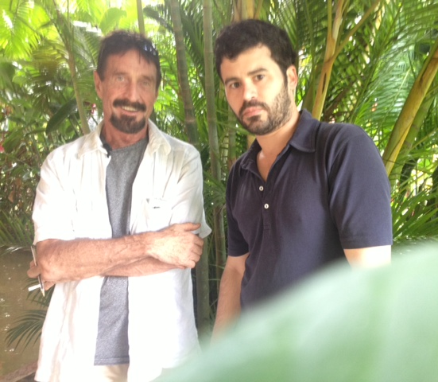
Metadata
Office Metadata (registered owner, last opened, last modified, last printed)
Where was this photo taken (GPS coordinates)? By what type of camera? and When?
http://exif.regex.info/exif.cgi

Slide 52
Extracting the Evidence
Many of the Forensic Tools create a pdf or html electronic report of “bookmarked” files.
You’ll need to explain the significance of the bookmarked files (somewhere).
You’ll need to place a Caution Statement on the “dirty” data:
“Caution: This media may contain executable code, viruses, contraband, obscene material, and/or Copyright protected data. This media should not be viewed on or introduced into a Classified computer system.”

Slide 53
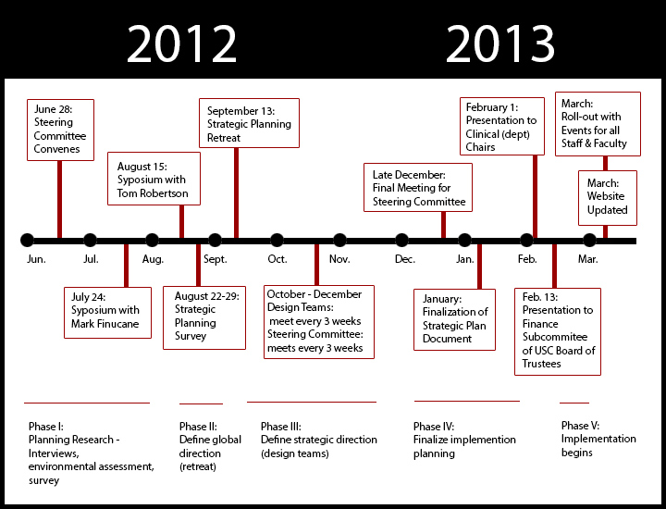
Timelines
You can combine timestamps from various artifacts for analysis
File system timestamps
E-mail timestamps
Internet activity timestamps
Windows Registry timestamps
Windows Artifacts timestamps
Event Logs
Web server logs
Packet Capture data, and more
Notes:
Timelines are good for showing Cause and Effect.

Slide 54
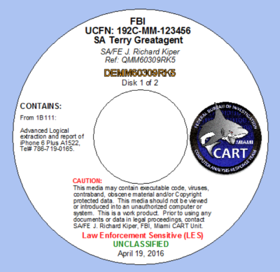
Documenting Your Results
Forensic Principle 3: The examination must be verifiable and repeatable.
Examination notes should be taken contemporaneously.
It may be appropriate to write a report summarizing your examination, explaining the results and answering the investigative questions posed.

Slide 55
Examination Workflow and Forensic Principles
Take detailed notes
Write-protect Evidence
Image (MD5 verify)
Pre-process Evidence
De-code files
Search the Evidence
Extract Evidence of Interest
Generate Reports
Forensic Principle 1: The evidence should not be altered.
Forensic Principle 2: The examination must be accurate.
Forensic Principle 3: The examination should be verifiable and repeatable.

Slide 56
Extra Activities?
RAM Capture
Mount image using Imager Lite
Load Bryant case and extract deleted data

Slide 57
Questions?

Slide 58
What we covered
Identify categories of digital evidence.
Define digital forensics.
Describe role of digital forensics in incident response.
Explain the three forensic principles.
Describe the digital forensics examination workflow.
Distinguish between a clone and an image.
Use FTK Imager to create an image of a thumbdrive.

Slide 59
What we covered
Explain the importance of MD5 verification.
Describe different methods for searching digital evidence.
Describe the value of the different types of artifacts found on digital evidence.
Use Registry Viewer to view registry files.
Explain the importance of documenting your results.

